Slide 1
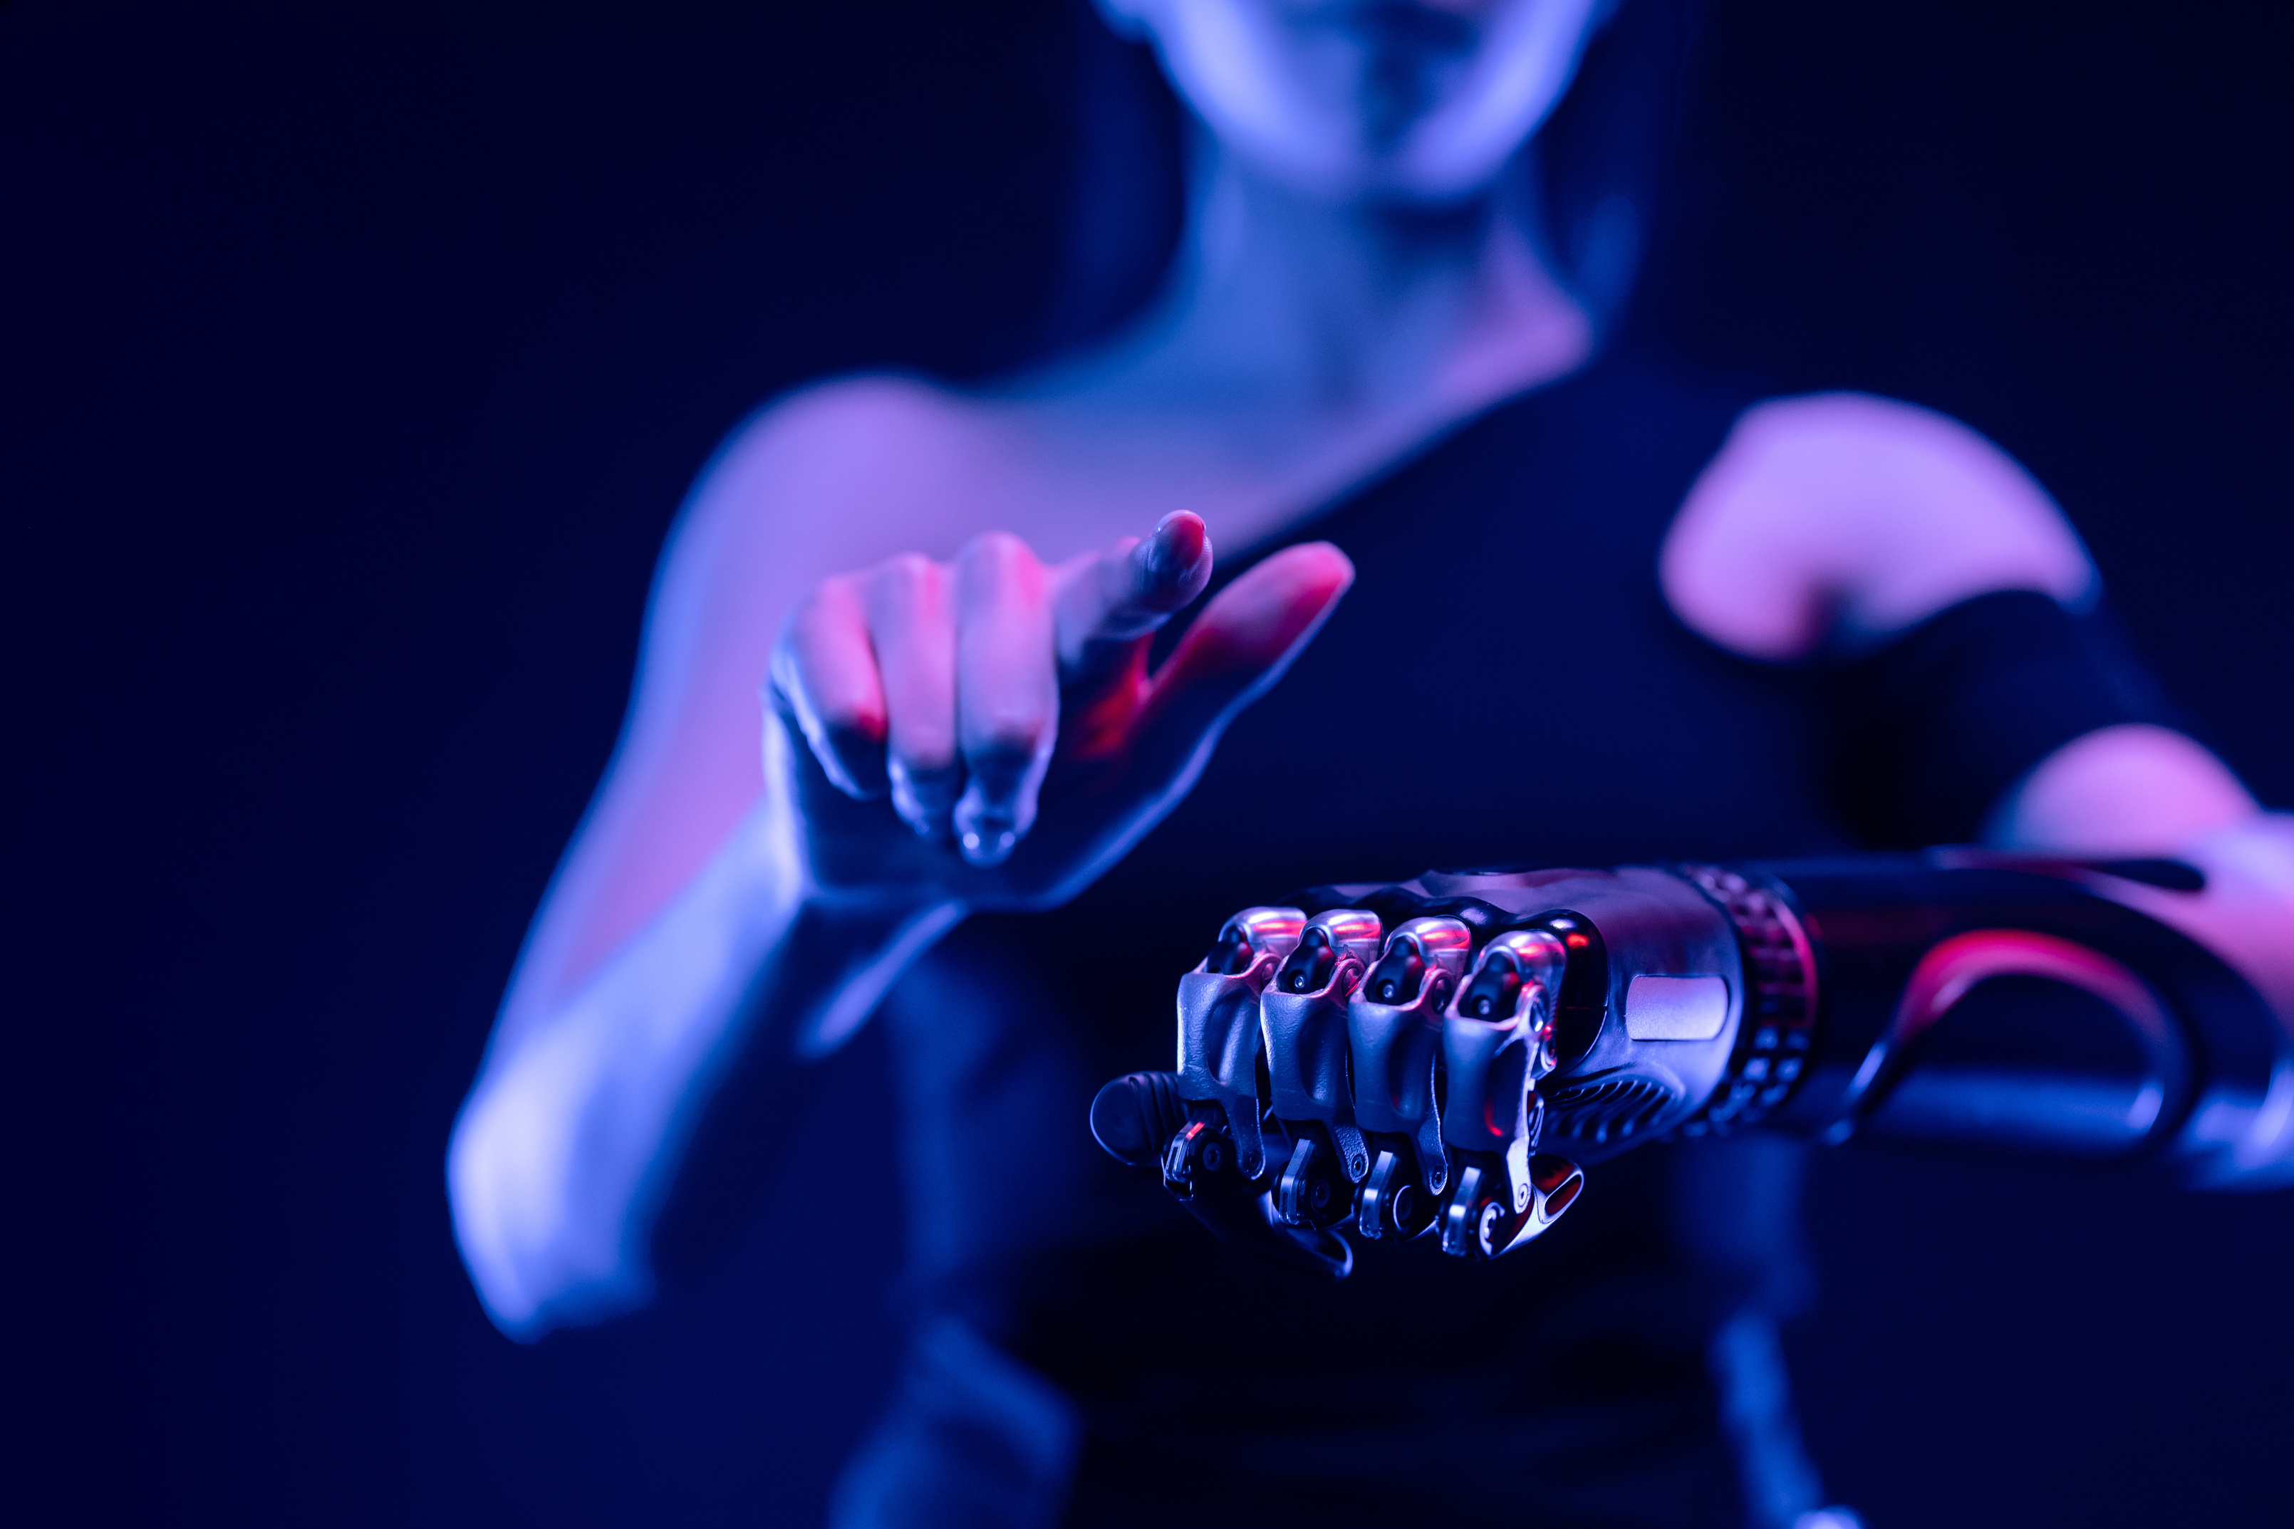
Presentation On
ARTIFICIAL INTELLIGENCE

Slide 2



What is AI
Artificial Intelligence (AI) is a set of technologies that allow machines to perform tasks that are similar to human intelligence.
Types of AI(Artificial Intelligence)
Narrow AI (Weak AI) :- Designed for specific tasks (virtual assistants like Siri , recommendation system, and self-driving.
General AI(Strong AI) :- A theoretical form of AI that can perform any intellectual task a human can.
Super AI :- A hypothetical AI that surpasses human intelligence in all aspects.

Slide 3


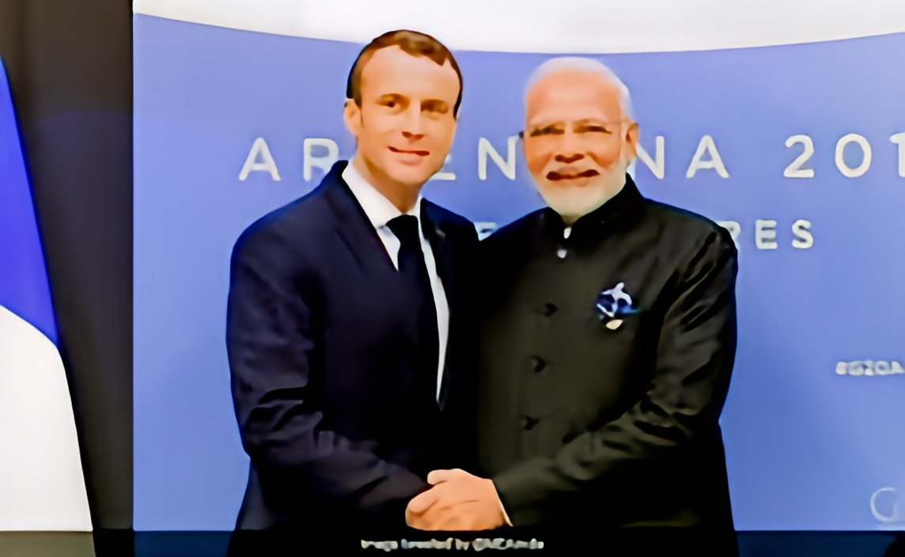
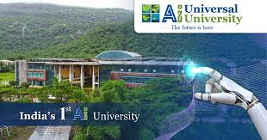
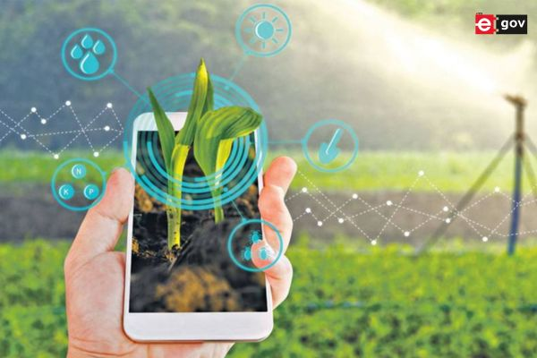
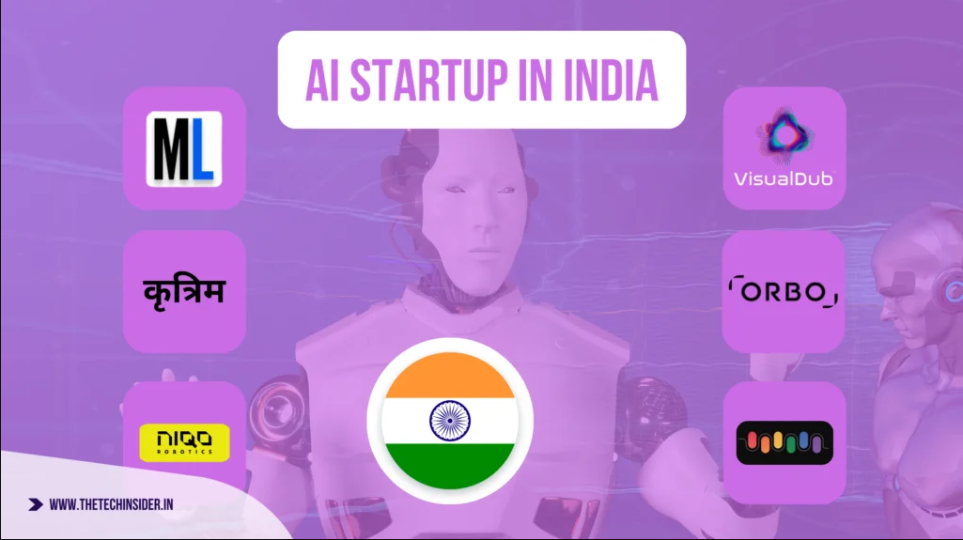
INDIA’S WORKS IN THE FIELD OF AI
AI ACTION SUMMIT 10-11
This summit conference will be held in Paris, capital of France. In which the prime minister of our country will be present at the speaker. This conference will be hosted by French president Emmanuel Macro.
Public service AI, Future of work, Innovation and culture, Trust in AI.
FIRST AI UNIVERSITY IN INDIA
India’s first AI University will be built in Maharashtra and has announced to create such a “CENTER OF EXECELLENCE”. In this University, works will be done in skill development of the country.
AGRICULTURE IMPROVE BY USING AI
The use of AI is proving to be helpful in increasing agricultural production in all areas, in making proper use of water and fertilizer, and in reducing the labor of farmers.
STARTUP
India’s AI startup ecosystem is growing rapidly. If you have strong AI based solution, a skilled team and a scalable business model in India.

Slide 4
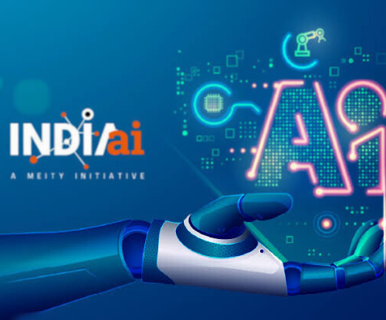
AI Ecosystem in India
Government Support: The India AI mission and policies promoting digital transformation are creating a environment for AI development.
Investment: Domestic and international investors are pouring money into Indian AI companies.
Startup Ecosystem: India has startup ecosystem, with many companies focusing on AI-powered solutions across various sectors.
India's AI ecosystem is dynamic and promising, with the potential to transform various sectors and drive economic growth.

Slide 5

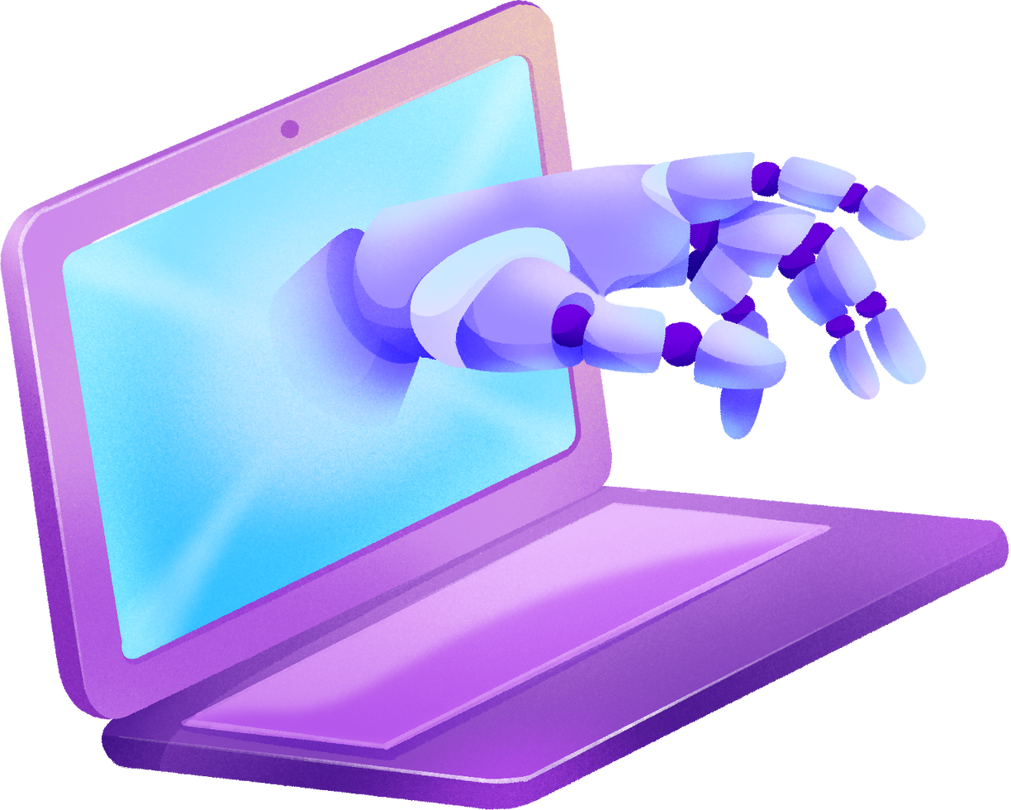

Essential skill required for future
There are some key skills that will be essential for the future In AI.
Technical Skills
Analytical & Problem solving
Soft Skills

Slide 6

WHY IS AI SO IMPORTANT TODAY
AI work on multiple areas
1. Solving Complex Problems:
Healthcare.
Climate Change.
Finance.
2. Innovation:
Transportation.
Communication.
Entertainment.
3. Personalization:
E-commerce.
Social Media.

